Slide 1

IP Addresses

Slide 2
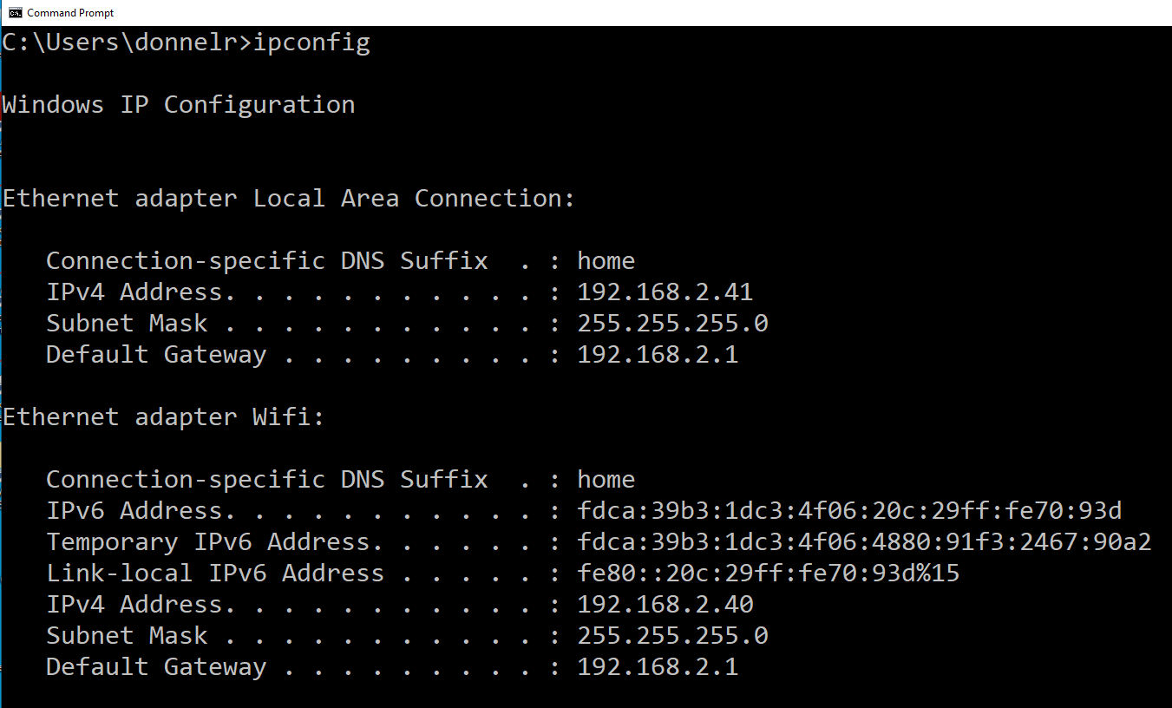
CMD

Slide 3

Basic Binary
Base 2
A single binary bit has two possible states. “on” or “off”
On = 1
Off = 0
This means there are two possibilities with a single bit. 0 or 1

Slide 4

Basic Binary
What if you have two binary bits?
You now have four possible states, or combinations of 0’s and 1’s:
00
01
10
11
You have 4 possibilities with two bits. (4 unique combinations)

Slide 5

Basic Binary
What if you have three binary bits?
You now have eight possible states, or combinations of 0’s and 1’s:
000
001
010
011
100
101
110
111
You have 8 possibilities with three bits. (Eight unique combinations)

Slide 6

Basic Binary
This doubles with each binary bit that you add:
1 bit = 2 combinations
2 bits = 4 combinations
3 bits = 8 combinations
4 bits = 16
5 bits = 32
6 bits = 64
…
These are powers of two.

Slide 7
An IP Address
32 binary bits long (2^32)
Represented for humans in dotted decimal (4 octets)
This: 192.168.20.1 Is really this: 11000000.10101000.00010100.00000001

Slide 8
An IP Address
32 binary bits long
Represented in dotted decimal (4 octets)
This: 192.168.20.1 Is really this: 11000000.10101000.00010100.00000001 Actually, it’s really 11000000101010000001010000000001

Slide 9
A subnet mask Identifies the the network portion of the address
IP address: 192.168.20.1
Subnet mask: 255.255.255.0
IP address: 11000000.10101000.00010100.00000001
Subnet mask: 11111111.11111111.11111111.00000000 (24 ones followed by 8 zeros)
NOTE: 255.255.255.0 can also be written as simply /24. Example: 192.168.20.1 /24 (This is called the “network prefix” or “CIDR notation.”

Slide 10
A subnet mask
IP address: 172.16.254.1
Subnet mask: 255.255.0.0
IP address: 10101100.00010000.11111110.00000001
Subnet mask: 11111111.11111111.00000000.00000000 (16 ones followed by 16 zeros)
NOTE: 255.255.0.0 can also be written as simply /16. Example: 172.16.254.1 /16

Slide 11

Same network?
172.16.255.1
255.255.0.0
And
172.16.0.20
255.255.0.0

Slide 12

Same network?
172.16.255.1
255.255.0.0
And
172.17.254.20
255.255.0.0

Slide 13
Powers of two
1 binary bit = two possible states
2¹=2
2 binary bits – four possible states
2²=4
2⁸ | 2⁷ | 2⁶ | 2⁵ | 2⁴ | 2³ | 2² | 2¹
 |  |  |  |  |  | 4 | 2

Slide 14
Convert binary to decimal
Positional values
128 | 64 | 32 | 16 | 8 | 4 | 2 | 1

Slide 15
Wireshark
What is Wireshark?
Starting WS and capture interfaces
Source and destination IP addresses (layer 3)
Source and destination MAC addresses (Layer 2)
Customizing columns
Local vs remote networks
Broadcast addresses

